Slide 1
TRASH, THE WORLD AND ME
Chiesa Erica, Lenti Valentina, Francescon Beatrice, Nodi Rossana

Slide 2
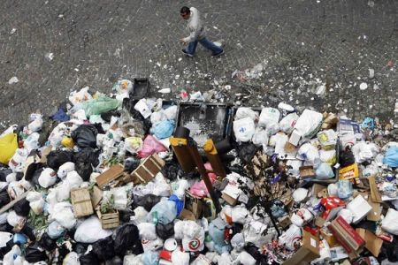
How much does our country make in waste every year?
We find out that in Italy there is a big production of waste every year: only in 2008 we produced millions of tonnes.
A street full of rubbish in Naples, Southern Italy.

Slide 3
Rubbish Dumps, Landfills and Recycling Plants near us
In Piedmont there aren’t many rubbish dumps and recycling plants. But we found some, for example:
A.M.V. (Azienda Multiservizi Valenzana), a rubbish dump in our city;
A.M.I.V. (Azienda Multiservizi Igiene Urbana), another rubbish dump in our district, in the city of Alessandria;
Servizi Ambientali Piemontesi Srl, a recycling plant in Spinetta Marengo, AL

Slide 4
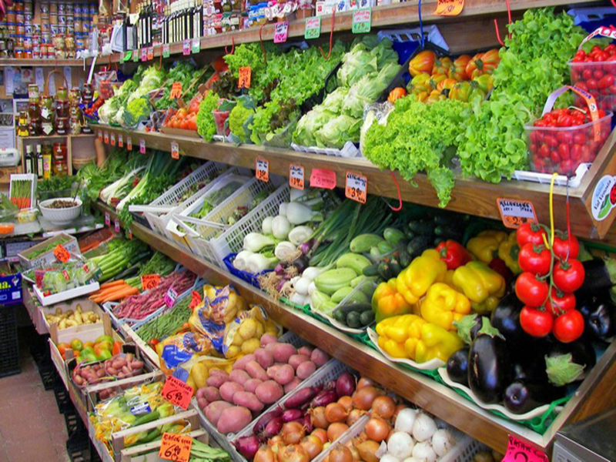
Some differences
Here there is a photo of an Italian grocery shop.

Slide 5
There are some differences with the grocery shop in the film we saw. We can see that in the Italian shop the quantity of goods is higher. Also, there are different types of goods. In the Italian grocery shop there is salad, peppers, tomatoes. In the other one we can’t see them, but we can find some pineapples, a lot of kiwis, some mandarins: all things that we don’t find in our photo.

Slide 6
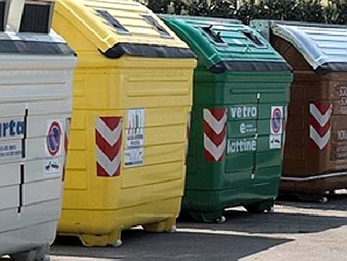
Our opinion about our area
We think many people don’t use bins because they don’t care a lot about the environment. Others, instead, know how much this can help the planet, so they use them and they don’t throw things on the ground. Also, a lot of people don’t recycle, because they simply don’t know the consequences.

Slide 7
An Italian project
In Italy, one of the most common project against pollution is the one that consists in planting trees. For example on the 2° December 2015, at the Congress Center of Piedmont in Turin, they presented the project «Un bosco per la città» («A wood for the city»), which consists of planting 276 thousands trees on 440 hectares of land throughout Italy. The cities partecipating in the project communicated the initiative to the local schools and associations.

Slide 8
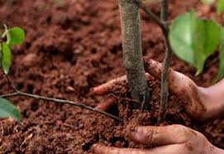
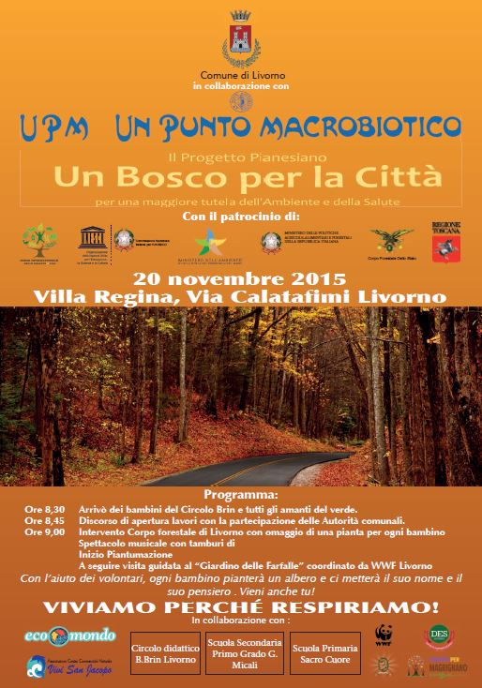
Then, they continued with the practical part of the project, which consists of planting trees and in the maintenance of the forests.
A flyer of the initiative

