Slide 1
Project: Trashed World
Trash, the world and me
Realized by:
Rebecca Lenzi
and
Rebecca Pagella
Istituto Benvenuto Cellini Valenza

Slide 2
WE DON’T WANT A TRASHED WORLD
During this project we learnt lots of interesting and important things. We understood that we have to be really careful about the environment. During these years we haven’t realized how serious the situation is and how it is getting worse.
Let’s check some facts in our area..

Slide 3
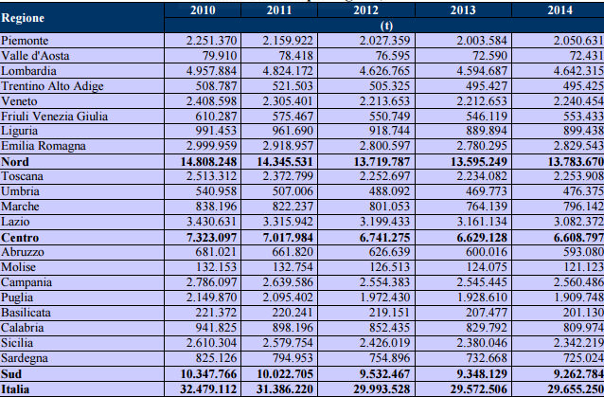
In 2014 Italy made 29.655.250 tonnes of waste and unfortunately the situation was worse than in 2013:

Slide 4
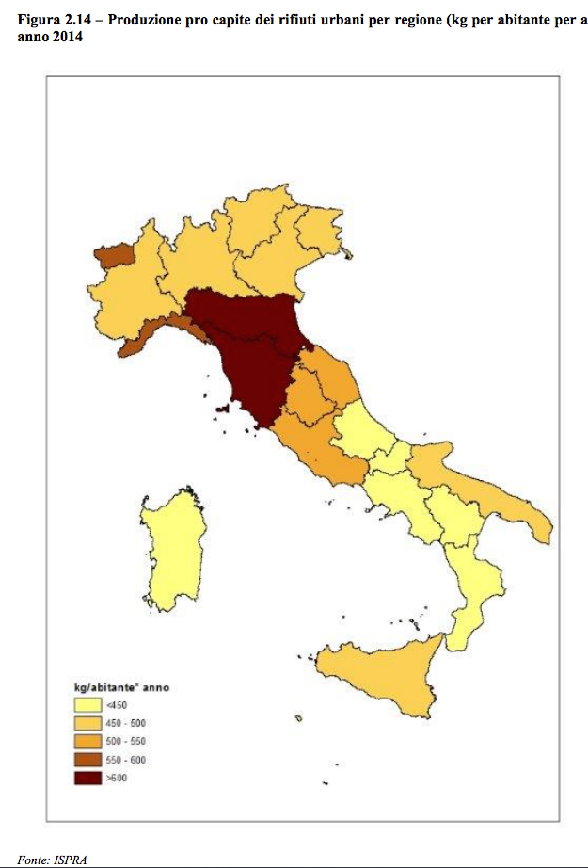
This is a map of Italy which depicts the production of trash in kilos per inhabitant in one year.
<450
450-500
500-550
550-600
>600

Slide 5
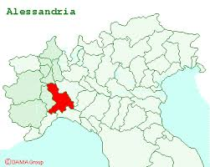
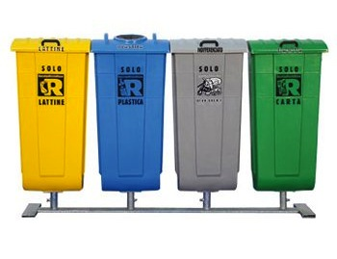
We live in the North-West of Italy, in the province of Alessandria.
This is a quite area, and the “trash-situation” is controlled by the region. Our territory is partecipating in a recycling project whose
goal is to separate the different kinds of trash (paper, plastic, glass etc.) to allow people to
reuse the major part of the trash.
In every house there
are four different bins: one for
paper, one for plastic, one for
organic waste and another for
glass. This allows people to
differentiate the trash more easily.

Slide 6
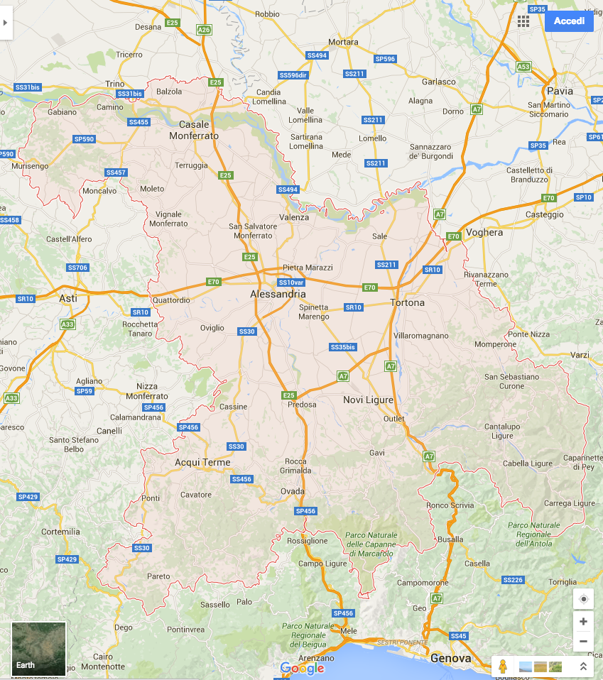
In our province there are three rubbish dumps
(
).

Slide 7
In our opinion people should care more about the world and about what is truly happening around us. Teachers or experts should begin to inform children, from a very young age, what everyone can do to protect the environment. But also parents should give a good example by recycling and keeping the world clean.

Slide 8
“TRASH MONSTER” IS DESTROYING US AND OUR WORLD.
LET THE ENVIRONMENT LIVE!
WE DON’T WANT A TRASHED WORLD.

