Slide 1
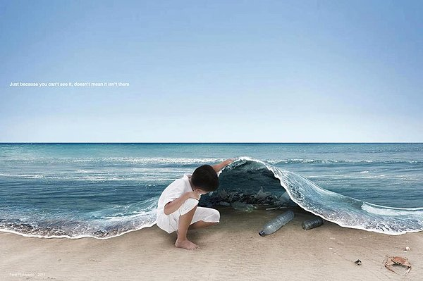
TRASH, THE WORLD AND ME
Recycle , reuse and reduce in Italy
REALIZED BY
Bianchi Giulia
Bonamico Carola
Spina Chiara Maria
Trabona Lucrezia

Slide 2
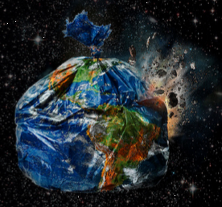
What this project is about
The trashedworld project is about world pollution, the waste that people produce and how we could solve the problems of disposal. In this presentation we’ll speak about Italy.

Slide 3
Waste problems in Italy
In the last two years the rubbish produced in Italy has decreased compared to the past. Here is some information about Italian annual waste:
2013: 31 386 tons;
2014: 29 994 tons;
2015: 29 573 tons.
Per person production (kg/inhabitant every year):
2013: 550 kg;
2014: 500 kg;
2015: 480 kg.
The information of the Waste Watcher 2015 shows that the main waste Italian people produce is food, in fact, Italian waste costs 8.4 billion Euros every year!

Slide 4
The main rubbish dumps and recycling plants
In Italy there are lots of rubbish dumps and landfills compared to recycling plants; anyway, a big percentagel of waste is recycled. The recycled materials are usually glass, plastic and paper:
45% of rubbish is recycled;
39% of waste is filled in rubbish dumps;
16% is incinerated.
WHERE DOES WASTE GO?

Slide 5
Projects in order to solve the waste problem
The European Union and Italy are working on some projects to help the environment and produce less waste:
Some SUPERMARKETS in Italy are busy reducing waste:
Coop uses the «3R strategy» (saving money, re-using and recycling) to decrease packaging waste production.
Ikea shares waste that is recycled or used for energy recovery.
The European Commission announced plans to recycle 70% of Municipal waste (MW) and 80% of packaging waste by 2030.
This proposal also includes a ban on burying recyclable waste
in a landfill. These new targets would create about 580 000 new
jobs.

Slide 6
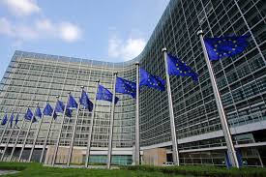
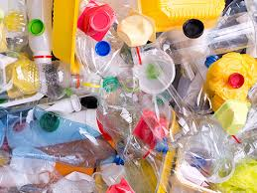
Projects in order to solve the waste problems
The EU launched the «GreenBottle Project» that created an innovative packaging for liquids which use up to 1/3 less plastic than conventional plastic bottles and significately less laminated carton. The GreenBottle Project packaging is also more environmentally friendly than glass!

Slide 7
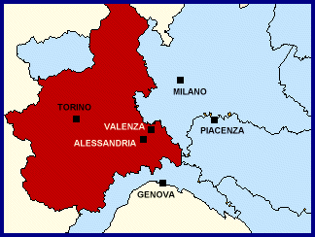
Information about our city
Valenza, Piedmont, is a litter-free area and our neighbourhood is relatively clean. In this town there are a lot of bins but sometimes people don't use them. We think people must use bins to save the environment and in Italy there are fines for people that throw away their rubbish.

Slide 8
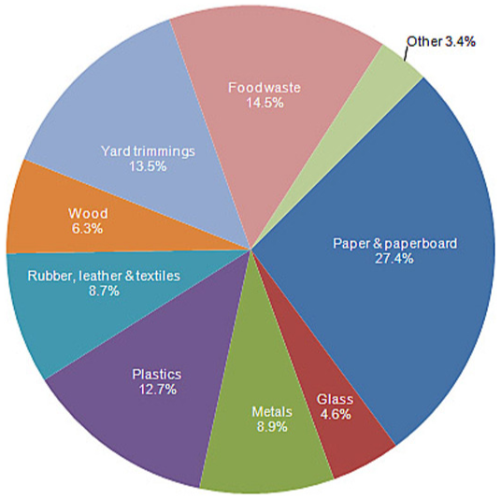
Waste at home
Italian families always separate paper, plastics and glass from other materials that are collected together.
There are also other types of waste such as batteries, oil and you can donate clothes to associations which need them!
People usually produce these percentages of materials

Slide 9
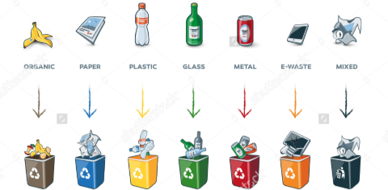
Where we can throw away rubbish
Rubbish and waste can be collected in different types of bins:
blue ones for paper;
green ones for glass;
brown ones for food and organic materials;
yellow ones for plastics;
black ones for metal.

Slide 10
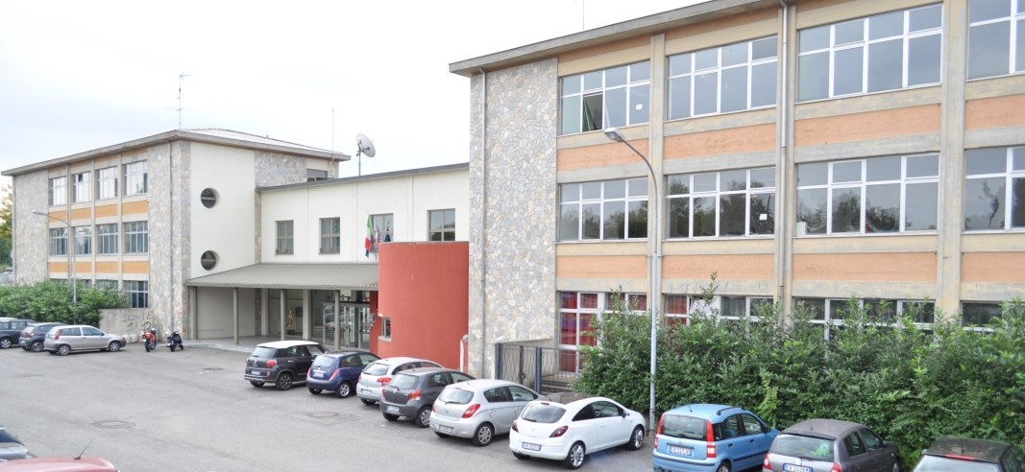
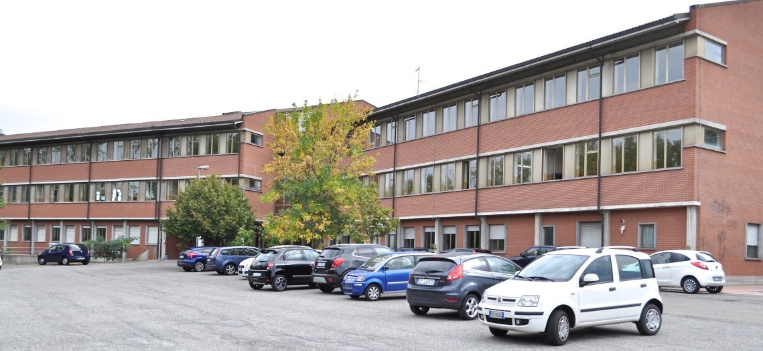
What we do at school: the project «Io differenzio… e tu?»
To minimize waste production at our school we devised a project that consists of separating paper and plastic from other materials to help the environment. We also do it to let people know that every little action is very important.

