Slide 1
Making a good presentation
Research, planning, putting together, delivery

Slide 2
Research
Prepare content
Prepare images
Prepare data
Know enough to feel comfortable

Slide 3
Planning Content
Tell, tell, tell
Title (exciting, clearly explains focus of research)
Content Time
Start (gives introduction to presentation) short (10%)
Body (main ideas of presentation) most (80%)
End (gives a conclusion) short (10%)
Time for questions (?)

Slide 4
Planning language and delivery
‘Please may I have your attention?’
Include tasks – quiz, questionnaire for during the presentation
Make a special event of the presentation, formal dress
Brainstorm a list of criteria for evaluation of the presentation (relevant, interesting)
How many evaluators?
Organize self evaluation, what would you do differently
Plagiarism (acknowledging sources)
Referencing
Use visuals
Body language

Slide 5
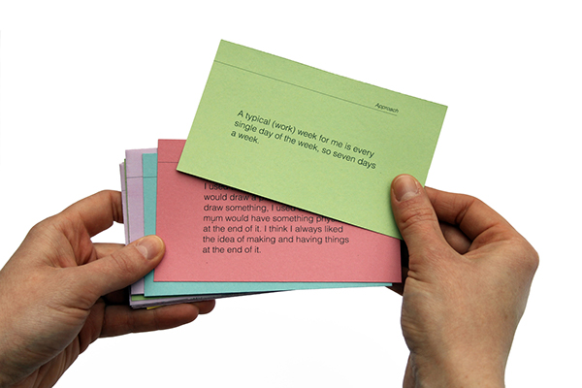
Putting together the presentation
Prepare cue cards
One for the start
One for each of the main ideas in the body
One for the end
On each card, key words, references to visuals
Put cards in order, number them
Make copies for team members

Slide 6
Delivery

Slide 7
Delivery
Good Presentation | Bad Presentation

